Slide 1
ecommerce B2B data analysis
PRESENTED BY-
MUNDHE yash

Slide 2
INTRODUCTION
This project aims to perform exploratory data analysis (EDA) on an Ecommerce B2B dataset to identify customers that give the highest business and orders. By using data science skills to draw insights from real market data, we can help businesses focus on sectors that can increase revenue.
The dataset is a transnational data set containing all the transactions occurring between 01/12/2010 and 09/12/2011 for a UK-based and registered non-store online retail that mainly sells unique all-occasion gifts. The customers of the company are mostly wholesalers, both local and international.
Source of data : ( https://archive.ics.uci.edu/ml/datasets/online+retail )

Slide 3
Aim
To perform EDA on the Ecommerce dataset and find insights that can be helpful to identify the customers that gives highest business and orders.
We will be using data science skills to draw insights that happen in real markets and what sectors company need to focus to increase revenues.

Slide 4
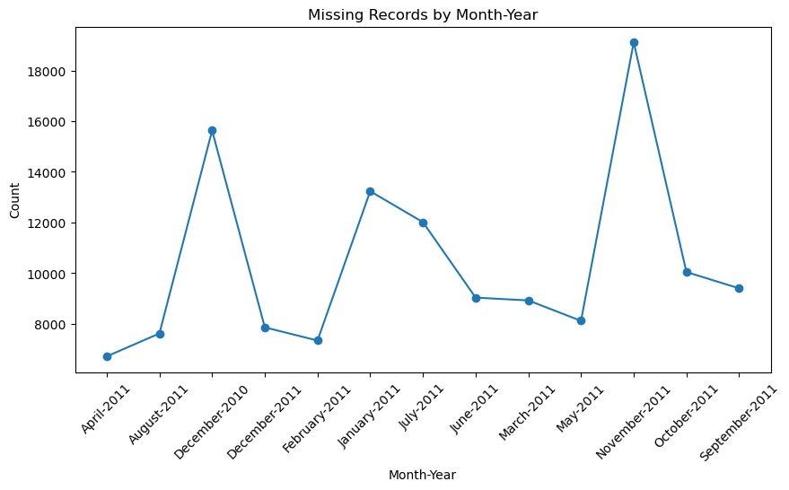
Data Analysis

Slide 5
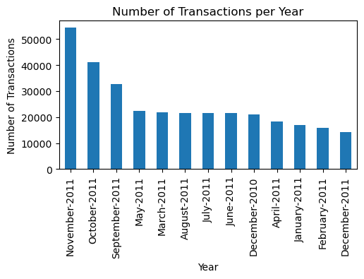
Data Analysis

Slide 6
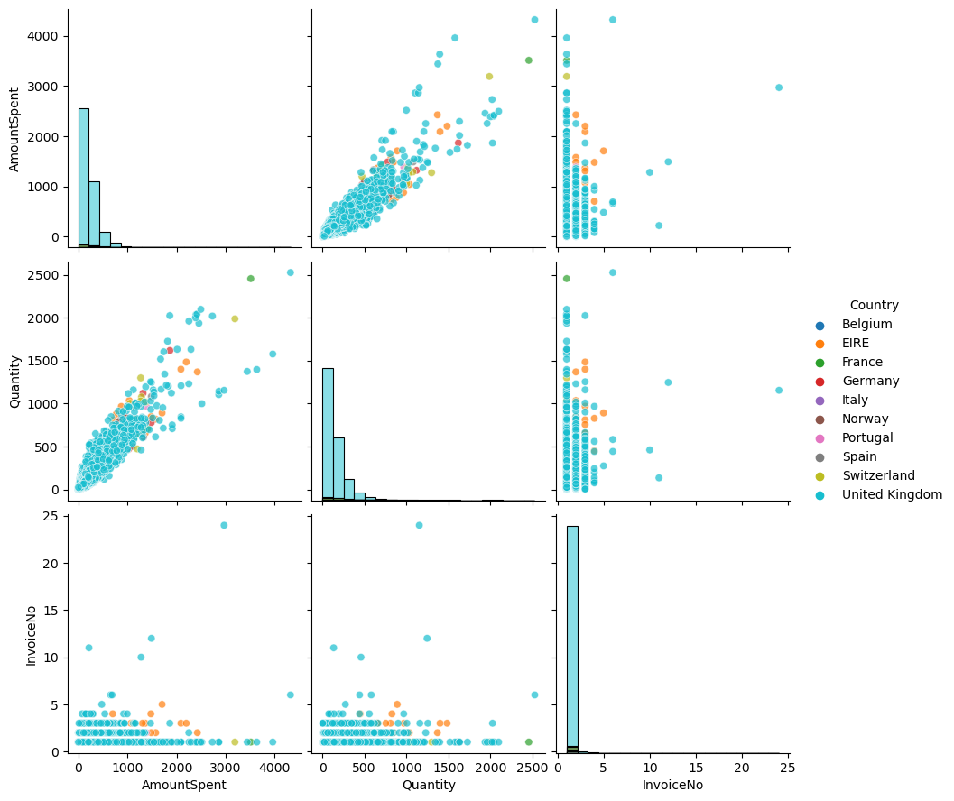
Data Analysis

Slide 7
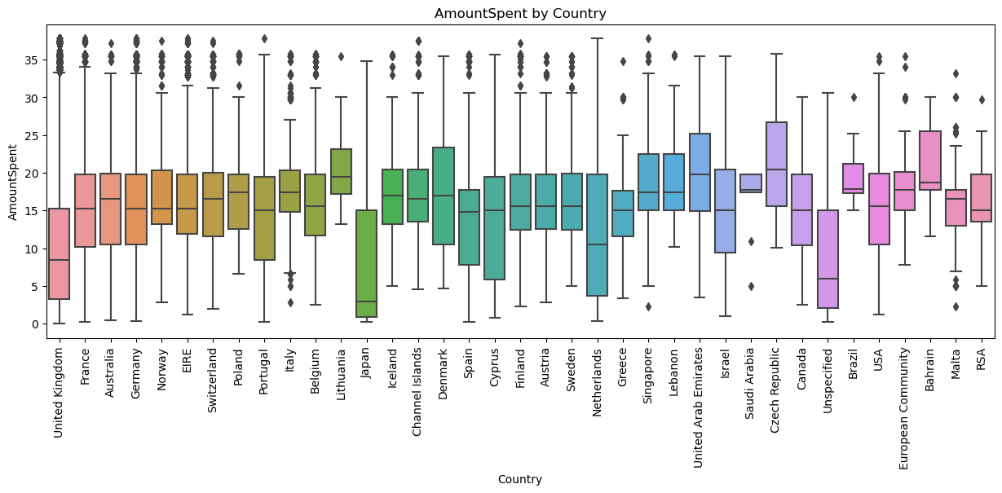
Data Analysis

Slide 8
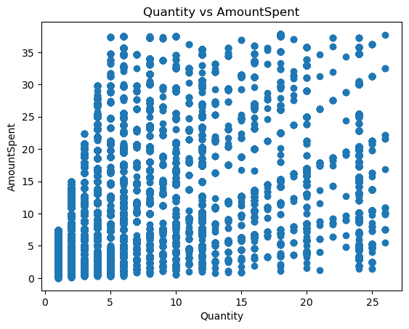
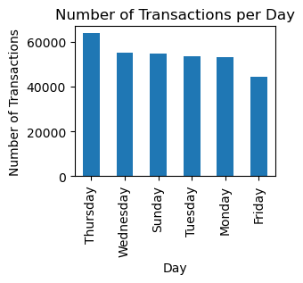
Data Analysis

Slide 9
CONCLUSION
United Kingdom Have Maximun Transaction
The Distribution Of Unit Price Is Right Skewed
In November Month Maximun Transaction Performed
Maximun Number Of Transaction On Thursday
Overall, The Ecommerce B2b Dataset Shows A Clear Trend Towards Higher Transaction Volumes And Amounts Spent During The Holiday Season, Particularly In November And December. Additionally, Customers From Certain Countries Such As United Kingdom, France, Germany, Eire Tend To Spend More Per Transaction Across Multiple Product Categories. It Is Recommended That The Company Focus On Increasing Sales During The Holiday Season And Targeting Customers From These Countries To Increase Revenue.

Slide 10
THANK YOU…!

